Slide 1
Employee Data Analysis using Excel
STUDENT NAME: MATHIAZHAGAN R
REGISTER NO:2213031036128 (NM ID : unm13032213031036128)
DEPARTMENT:COMMERCE (B.COM)
COLLEGE:DR.AMBEDKAR GOVT. ARTS COLLEGE VYSARPADI CHENNAI-600039

Slide 2
PROJECT TITLE
Employee Performance Analysis using Excel

Slide 3


AGENDA
Problem Statement
Project Overview
End Users
Our Solution and Proposition
Dataset Description
Modelling Approach
Results and Discussion
Conclusion
3/21/2024 Annual Review

Slide 4

PROBLEM STATEMENT
The organization seeks to improve overall workforce productivity and effectiveness by analyzing employee performance. The current performance evaluation system lacks objectivity and fails to identify key areas for improvement. To address these issues, the organization needs a robust performance analysis framework that can:
Assess Performance Metrics : Identify and quantify relevant performance indicators such as productivity, quality of work, adherence to deadlines, and collaboration skills.
Benchmark Performance : Establish benchmarks and performance standards for different roles and departments to facilitate fair comparisons.
ChatGPT 4o mini Log in You said: Employee Performance Analysis Problem Statement ChatGPT said: ChatGPT To help you with an Employee Performance Analysis problem statement, it would be helpful to know the specifics of what you're looking to address. However, a general problem statement for such an analysis could be: Problem Statement: The company aims to enhance its operational efficiency and employee satisfaction by implementing a robust performance analysis system. The current system lacks comprehensive metrics and actionable insights, leading to inconsistent evaluations and potential biases in employee reviews. Objective: To develop a detailed employee performance analysis framework that evaluates employee performance based on objective metrics, identifies areas for improvement, and aligns performance evaluations with organizational goals. This framework should incorporate quantitative data, qualitative feedback, and industry benchmarks to provide a holistic view of employee performance. Key Requirements: Metrics Identification: Define relevant performance metrics that align with organizational goals, such as productivity, quality of work, adherence to deadlines, and teamwork. Data Collection: Develop methods to systematically collect and record performance data, including self-assessments, peer reviews, and manager evaluations. Analysis Framework: Create algorithms or models to analyze performance data and identify patterns, strengths, and areas needing improvement. Reporting Tools: Design user-friendly reporting tools to present performance insights to managers and employees, facilitating actionable feedback and development plans. Bias Mitigation: Implement strategies to minimize biases in performance evaluations, ensuring fairness and consistency.

Slide 5
Enhance Feedback Mechanisms : Improve the feedback process to ensure it is constructive, actionable, and timely, promoting continuous employee development and engagement.
Analyze Performance Data : Utilize performance data to identify patterns, trends, and areas for improvement, and to inform strategic decisions related to employee development and resource allocation.
Implement Effective Development Programs : Design and implement targeted development programs based on performance analysis to enhance skills, address weaknesses, and leverage strengths.

Slide 6

PROJECT OVERVIEW
Project Object : GOAL : To evaluate and enhance employee performance, leading to increased productivity, job satisfaction, and organizational efficiency. PURPOSE : Identify strengths and weaknesses, set clear performance benchmarks, and develop actionable strategies for improvement.
TIMELINE : Week 1-2: Define objectives and collect data. Week 3-4: Analyze data and identify trends. Week 5: Prepare report and recommendations. Week 6: Present findings and finalize action plan.

Slide 7
SCOPE : Inclusions : Detail what aspects of performance will be analyzed (e.g., productivity, quality of work, attendance). Exclusions : Clarify what will not be covered (e.g., non-work-related issues). Timeframe: Outline the duration of the project and key milestones.
RESOURCES : Performance management software Data analysis tools (e.g., Excel, SQL, BI tools) HR and departmental input Access to performance data and feedback channels

Slide 8

WHO ARE THE END USERS?
In Employee Performance Analysis, the end users typically include: Managers and Supervisors : They use performance data to assess employee effectiveness, make decisions on promotions, provide feedback, and identify training needs.
Human Resources (HR) Professionals : They utilize performance analysis to support overall talent management strategies, including recruitment, training, and organizational development.
Excuetives and Senior Leadership : They use aggregated performance data to make strategic decisions about company performance, workforce planning, and overall organizational effectiveness.

Slide 9
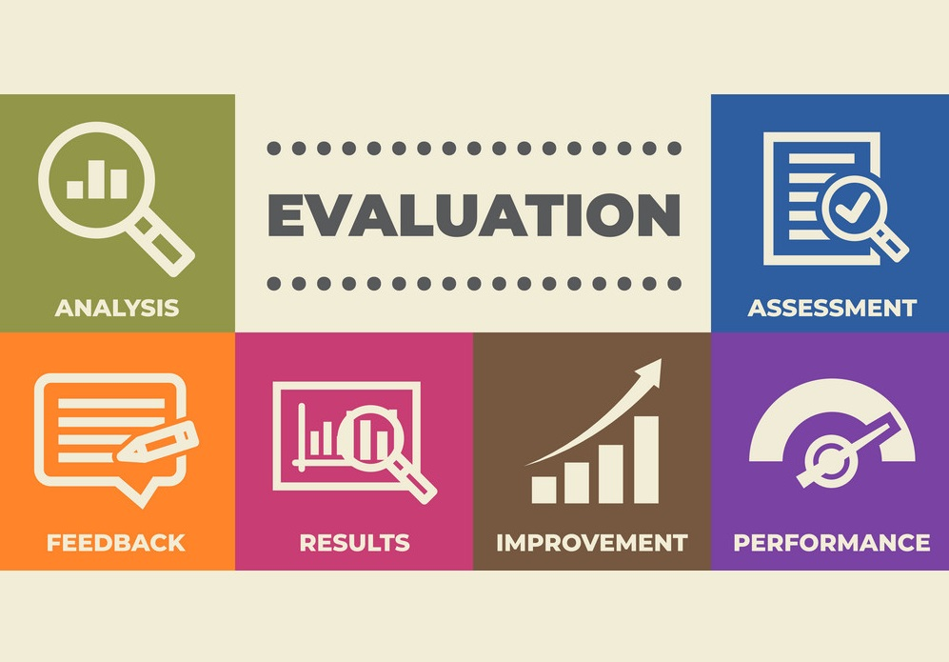
Executives : They use aggregate performance data to inform strategic decisions, allocate resources, and drive overall organizational effectiveness. Team Leaders : They monitor and assess the performance of their team members to optimize team dynamics and productivity.

Slide 10

OUR SOLUTION AND ITS VALUE PROPOSITION
SOLUTION OVERVIEW :
Our solution provides a comprehensive platform for evaluating and enhancing employee performance. It integrates data collection, analytics, and actionable insights into a user-friendly interface, offering a holistic view of employee productivity and development.
KEY FEATURES :
Real-Time Analytics : Continuous monitoring of performance metrics with real-time updates.
Customizable Dashboard : Personalized views for managers and employees to track progress and set goals.
AI Powered Insights : Predictive analytics to identify potential performance issues and recommend targeted interventions.

Slide 11
VALUE PROPOSITION : Data-Driven Insights : Our platform leverages advanced analytics to deliver actionable insights, helping managers make informed decisions based on comprehensive. Customized Performance Metrics : Tailored to your organization's specific needs .
Improved Employee Engagement : Offers employees clear visibility into their performance and development areas, fostering a culture of continuous improvement and engagement.
Reduced Turnover : By addressing performance issues proactively and supporting employee development, the system helps reduce turnover rates.
Operational Efficiency : Streamlines the performance review process with automated data collection and analysis, saving time and reducing administrative overhead.

Slide 12
METHODS OF EMPLOYEE PERFORMANCE DATASET ANALYSIS :
1.CONDITIONAL FORMATING - MISSING VALUES
2.SORT & FILTER - REMOVE
3.FORMULA PRESENTATION - IDENTIFY THE PERFORMANCE LEVELS
4.PIVOT - SUMMARY
5.GRAPH - DATA VISUALIZATION

Slide 13
Dataset Description
When conducting an employee performance analysis, you need to gather and describe various types of data to evaluate employee performance effectively. Here are the key types of data typically involved:
Data Description Such as ;
Website - KAGGALE
Features - 26
My Analysis - 9 Features
Employee ID :
Name - TEXT
Employee Type ;
Starting Date & Exit Date
Gender - MALE or FEMALE
Curent Employee Rating & Performance Level etc..,

Slide 14

THE "WOW" IN OUR SOLUTION
ADDITIONAL METHOD :
ADDING THE FORMULAS OF PERFORMANCE LEVEL .
PERFORMANCE LEVEL = IFS(Z8>=5,"VERY HIGH",Z>=4,"HIGH",Z>=3,2,1,"MED,TRUE,LOW .
It's very Useful to Identify the Employee Performance Level.
3/21/2024 Annual Review
14

Slide 15
MODELLING
DATA COLLECTION ;
1) KAGGALE
2) Download the Employee Dataset to Extract into Excel
3)Prepred the Employee Dataset Analysis in Excel
FEATURES COLLECTION ;
1) There are 26 Features in Dataset
2) My Analysis 9 Features
3) Additional Method of Identity the Performance Level.
DATA CLEANING ;
1) Identify the Missing Values.
2)Missing Values Sort & Filter.
15

Slide 16
PERFORMANCE LEVEL ;
There are three List's of Level
1) Very High
2) High
3) Medium ,True and Low
SUMMARY ;
1) Pivot Table
2) Additional Column of Performance Level
3) Graph to analyse of Employees Dataset

Slide 17
VISUALIZATION ;
1) Data Collection
2) Rating the Employees
3) Gender
4) Level of Performance
5) Given Formulas of Performance Level

Slide 18
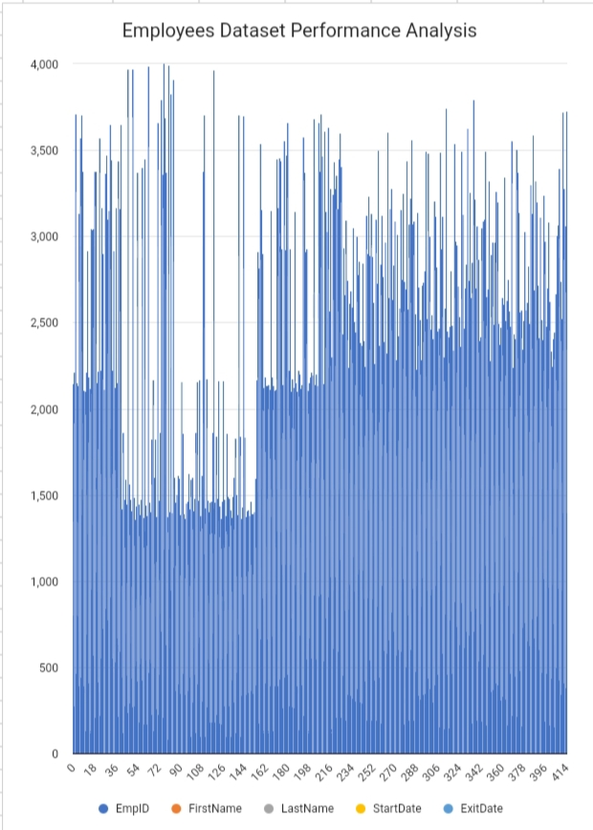
RESULTS
18

Slide 19
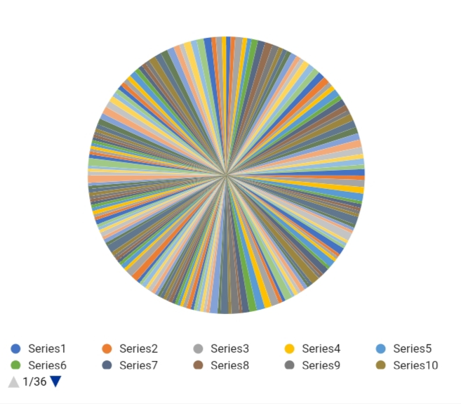

Slide 20
conclusion
In analyzing an Employee Performance dataset, the conclusion typically summarizes key insights and actionable recommendations derived from the data. Here’s a structured approach to formulating a conclusion:
Summary of findings :
Performance Trends: Highlight overall trends in employee performance. For instance, are most employees meeting, exceeding, or falling short of performance expectations?
Key Drivers: Identify factors that significantly impact performance, such as experience, department, training, or managerial support.
Performance Distribution: Discuss the distribution of performance ratings across different employee groups or departments.

Slide 21
Patterns and Insights :
High Performers: Who are the top performers and what common traits or conditions do they share?
Low Performers: Similarly, identify commonalities among employees with lower performance ratings.
Training Needs: Determine if there’s a need for additional training or resources based on performance gaps.
Recommendations :
Improvement Strategies: Suggest strategies to address performance issues, such as targeted training programs or changes in management practices.
Resource Allocation: Recommend adjustments in resource allocation or team composition to enhance overall performance.

